Slide 1
Grampians Region HACC Program Continence Care in the Community for Community Support Workers
November 2014

Slide 2
Grampians Region HACC Program - Continence Care in the Community
What is Continence?
The Normal Bladder
Dryness at all times
Voiding 4-6 times per day & 0-1 times at night
Passing 250-400 mls of urine per void
Ability to defer as long as required to get to the toilet
Passing a continuous stream of urine without burning or pain
Sense of complete emptying once finished
The Normal Bowel
Bowel action between 3 times per day to 3 times per week
Soft, formed stool
Passage of stool without straining
Have sensation of rectal fullness and warning prior to passage

Slide 3
Grampians Region HACC Program - Continence Care in the Community
Continence is complex….
To be continent you need to be able to:
Be aware of an urge to void/defecate
Know what to do and where to go
Be able to get there & manage your clothing
Store urine/bowel motion until the right time
Empty bladder/bowel on cue
Manage wiping/drying/clothing

Slide 4
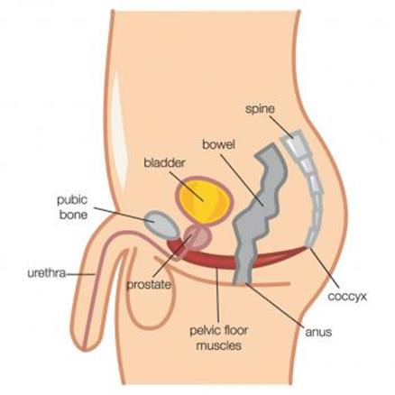
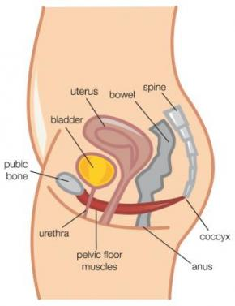
Grampians Region HACC Program - Continence Care in the Community
Pelvis and bladder with pelvic floor muscles

Slide 5
Grampians Region HACC Program - Continence Care in the Community
Incontinence is …..
Loss of control of the bladder or bowel that is involuntary and socially unacceptable
It is a symptom ….. not a disease
It is something that affects all ages

Slide 6
Grampians Region HACC Program - Continence Care in the Community
The extent of the problem
Up to 4.8 million Australians
1 in 4 women
1 in 10 men
People of all ages not just the elderly or disabled
15 – 22% of hospitalized patients
Over 50% of the elderly in residential care
Significant costs to community, acute and residential care facilities
2008/09 - $201.6 million spent in Australia

Slide 7
Grampians Region HACC Program - Continence Care in the Community
The myths about Incontinence
A normal part of ageing
Expected with childbearing
There is nothing that can be done
“I am the only one”
Children will grow out of wetting
It is not a serious problem

Slide 8
Grampians Region HACC Program - Continence Care in the Community
But there can be age related changes:
Altered urine production
Hormonal changes
Decrease in strength of pelvic floor muscles
Prostatic hypertrophy (Enlarged Prostate)
Neurological changes
Mobility and dexterity
Medical conditions
Current medications

Slide 9
Grampians Region HACC Program - Continence Care in the Community
Types of Urinary Incontinence
There are different types of urinary incontinence therefore:
We need to identify the cause of the symptoms
Different types of incontinence require different treatments
We need to collect information so the correct type of management plan can be put in place

Slide 10
Grampians Region HACC Program - Continence Care in the Community
Types of Urinary Incontinence
Stress Incontinence
Urge Incontinence
Overflow Incontinence
Functional Incontinence

Slide 11
Grampians Region HACC Program - Continence Care in the Community
Types of Urinary Incontinence
Stress Incontinence
Involuntary loss of a small amount of urine, when coughing, sneezing, laughing or on change of position
Weakened sphincters & pelvic floor muscles
Excessive intra-abdominal pressure
Difficulty stopping urine flow mid stream

Slide 12
Grampians Region HACC Program - Continence Care in the Community
Types of Urinary Incontinence
Stress Incontinence - Causes
Weakened Pelvic Floor Muscles
Childbirth (Trauma)
Persistent Heavy Lifting
Obesity
Chronic Cough
Straining to pass a stool
Fall in oestrogen levels may cause a weakness in pelvic floor muscles
Congenital weak sphincter mechanism
Sphincter damage post surgery

Slide 13
Grampians Region HACC Program - Continence Care in the Community
Types of Urinary Incontinence
Urge Incontinence
Involuntary loss of urine associated with a strong desire to void
Often comes with little warning
Usually as the result of an over contraction of the bladder muscle

Slide 14
Grampians Region HACC Program - Continence Care in the Community
Types of Urinary Incontinence
Urge Incontinence
Over Active Bladder
Unable to hang on
Urgency
Large Volume of urine
Frequency

Slide 15
Grampians Region HACC Program - Continence Care in the Community
Types of Urinary Incontinence
Urge Incontinence - Causes
Urinary Tract Infection
Cystitis / Calculi / Tumours
Constipation
Caffeine / Food Additives
Medications (Diuretics)
Anxiety
Neurological Disorders (CVA, Multiple Sclerosis, Parkinson’s Disease)

Slide 16
Grampians Region HACC Program - Continence Care in the Community
Types of Urinary Incontinence
Overflow Incontinence
Inability to pass urine – so it builds up and overflows
Blockage of bladder outlet / obstruction
Enlarged prostate, strictures, sphincters not relaxing on cue
Faecal Impaction
Bladder Muscle not contracting sufficiently

Slide 17
Grampians Region HACC Program - Continence Care in the Community
Types of Urinary Incontinence
Overflow Incontinence – symptoms
Constant leakage or dribbling
Post void dribble
Difficulty starting flow / hesitancy
Poor stream / interrupted
Feeling of incomplete bladder emptying
Frequency – small urinary volumes
UTI – Urinary Tract Infection
Distended abdomen: painful or painless
Confirmed with a portable bladder scan

Slide 18
Grampians Region HACC Program - Continence Care in the Community
Types of Urinary Incontinence
Functional Incontinence
The sensation to void is present but the person is unable to reach the toilet in time

Slide 19
Grampians Region HACC Program - Continence Care in the Community
Types of Urinary Incontinence
Functional Incontinence – Causes
Impaired mobility
Impaired dexterity – Unable to remove clothing
Cognitive impairment
Environmental Reasons:
Location of toilets
Availability of toilets
Chair or Toilet Height

Slide 20
Grampians Region HACC Program - Continence Care in the Community
Maintaining Bowel Control
Requires several factors:
Effective barrier to outflow provided by the internal and external sphincters
A normal rectum that stretches and can hold a good volume of stool and then is able to contract to empty
Intact anal sensation
Bulky and firm stools (but not hard)

Slide 21
Grampians Region HACC Program - Continence Care in the Community
Faecal Incontinence
Loss of control of the bowel in an inappropriate time and place
May be leakage of gas, liquid or solid stool

Slide 22
Grampians Region HACC Program - Continence Care in the Community
Constipation
The infrequent passage of bowel motions
The stool may be hard or lumpy, the person may need to strain to pass the stool, they may have a feeling of incomplete evacuation and may pass less than 3 bowel motions a week
It is more common in women than men, especially younger (20ish) and older women
26% of men & 34% of women over 65 years report constipation
30 – 50% of elderly people regularly use laxatives
Constipation has been shown to decrease quality of life and well being.

Slide 23
Grampians Region HACC Program - Continence Care in the Community
Common conditions associated with Constipation in the elderly
Immobility
Dehydration and/or inadequate Diet
Neurological Causes
Spinal Cord, MS, Parkinsons Disease
Gut lesions
Obstructions – Carcinoma’s
Post Surgery Abnormalities
Haemorrhoids
Intestinal Conditions ie. Diverticular Disease
Cognitive Impairment
Medications

Slide 24
Grampians Region HACC Program - Continence Care in the Community
Why is Continence Important?
It has significant impacts on:
An individual’s dignity, self-esteem and wellbeing
Health – Dehydration and inadequate diet, skin integrity, poor sleep
Personal & Intimate Relationships
Social Interactions – Afraid to socialise and go out of the home
Income – Cost of Continence Aids, can reduce spending on other activities
Household Tasks – Increased Washing
Future – May be a significant contributing factor in the decision to admit to residential aged care

Slide 25
Grampians Region HACC Program - Continence Care in the Community
Signs that a client may be incontinent
Smell (odour) when entering the home or when assisting a client
Poor Skin Integrity or discomfort while assisting to wash
Soiled clothing or often client stays in their night wear
Wet Bed or bed already stripped when you arrive
Increased changing & washing of clothes and bed linen
Wet spots on furniture
Not wanting to leave the home for shopping, appointments or for social occasions
Not drinking or eating much (or Client may be ill)
Not taking Diuretic Medication
Cancelling visits of support staff at the last minute
Not as chatty and outgoing as previously
Always tired and complaining of lack of sleep

Slide 26
Grampians Region HACC Program - Continence Care in the Community
What should I do if I think there is an incontinence problem?
Many people with a continence problem do not seek help because of embarrassment, shame or they think that nothing can be done
If you have a comfortable relationship with the client, talk with the client about what is bothering them or the changes that you have observed
Use a gentle, calm tone of voice
Choose simple words & short sentences
Actively listen to the client, be careful not to interrupt
Offer reassurance that the problem can be assessed and a possible treatment or management can be found

Slide 27
Grampians Region HACC Program - Continence Care in the Community
What should I do if I think there is an incontinence problem?
Document: Community Support Worker Process Guide
Report your concerns to your supervisor
Complete written documentation (Screening Tool, Memo or Request for Review form) clearly explaining why you have these concerns or what you may have observed
If you have spoken to the client about your observations, report their responses
The Assessment Officer will follow up with the client and if a problem is identified, will discuss with the client possible referral and support

Slide 28
Grampians Region HACC Program - Continence Care in the Community
Referral Pathways
Document: Referral Pathways
The Assessment Officer
Referral & Support
Clients may already be attending a Continence Clinic or consulting their GP in regard to Continence problems
The client may choose to consult their GP
The client may decide to self refer to a Continence Nurse/Clinic
The client may prefer for the Assessment Officer to make a referral to an appropriate provider on their behalf
Provision of contact details or information on how to access continence aids for short time use

Slide 29
Grampians Region HACC Program - Continence Care in the Community
What services may be able to assist the client or their carer?
General Medical Practitioners
Continence Nurses & Continence Clinic
Specialist Physiotherapists
Occupational Therapists – Home Modifications
Memory & retraining specialists
Financial Assistance for the cost of Continence Products (if eligible)
Continence Foundation of Australia
Carers Support

Slide 30
Grampians Region HACC Program - Continence Care in the Community
How can I assist my client with their Continence Management Plan?
If your client requires ongoing continence support to be provided by the Community Support Worker the Continence Service will complete a ‘Service Handover Plan – Personal Care Tasks’ tool
For some tasks Client Specific Training will need to be undertaken with the Continence Service
Document: Role of the Community Support Worker

Slide 31
Grampians Region HACC Program - Continence Care in the Community
Continence Products
The Continence provider will advise on the best products for each individual taking into account:
What type of incontinence and the amount of urine/faeces accidently lost
The gender of the person
The size and shape of the person
Who is available to assist the client to change products (if needed)
What can be afforded
How active the person is / social needs

Slide 32
Grampians Region HACC Program - Continence Care in the Community
Types of Continence Products
Disposable and reusable pads
Disposable and reusable pants
Urinals, Bed Pans and Commodes
Condom drainage
Catheters – Intermittent, Indwelling & Supra-pubic
Leg Bag and Night Bag or Bottle
Flip Flow Valve
Chair protection
Bed protection

Slide 33
Grampians Region HACC Program - Continence Care in the Community
Fluid or Bowel Charts
As a Community Support Worker you may be asked to assist a client to keep a Fluid Chart or a Bowel Chart
A Bowel Chart collects the following:
Timing of Bowel Motions
Stool Consistency and Size (Next slide)
Any Incontinence – when, what, how much, warning or awareness
Observation of straining, pain, mucous, blood …..
Record anything taken for the bowels

Slide 34
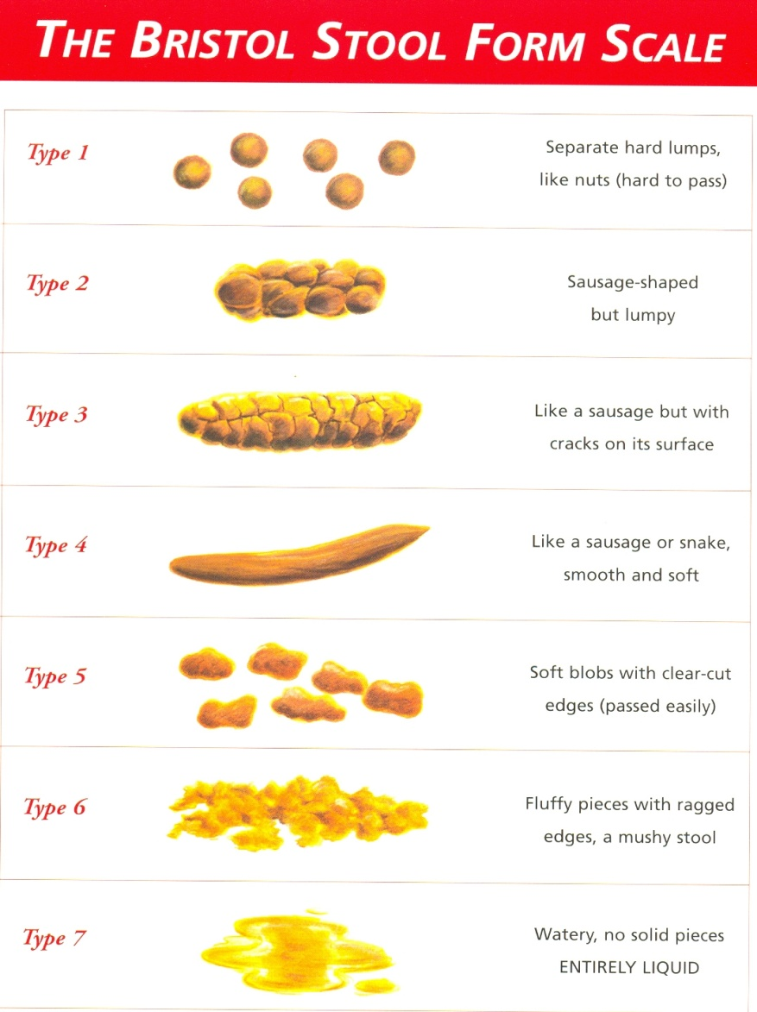
Grampians Region HACC Program - Continence Care in the Community
Fluid or Bowel Charts

Slide 35
Grampians Region HACC Program - Continence Care in the Community
Prevention does help…..
Drink Well – 1.5 – 2 litres of fluid per day
Eat a Healthy Diet
Lead a Positive Lifestyle – Ideal Body Weight & Stop Smoking
Get Active – 30 minutes a day
Practice Good Toilet Habits
Correct sitting position on the toilet (next slide)
Get help if you experience bladder or bowel control problems

Slide 36
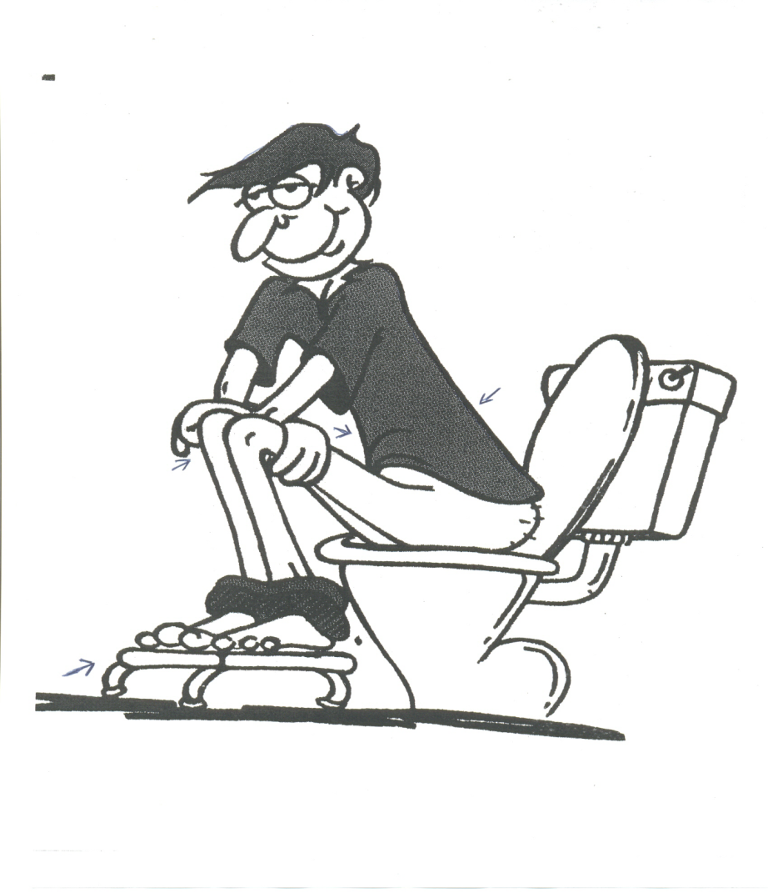
Grampians Region HACC Program - Continence Care in the Community
Prevention does help…..

Slide 37
Grampians Region HACC Program - Continence Care in the Community
Resources &
Further Information
Websites
Continence Foundation of Australia www.continence.org.au
Further Training
e3Learning
Other Courses

Slide 38
Grampians Region HACC Program - Continence Care in the Community
Questions????

